Slide 1

Theory of Computation
CSE ( CET2008B)
TY BTech
Unit III
CFG and PDA

Slide 2
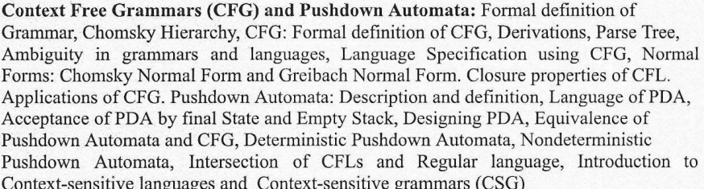
Unit- III
Context Free Grammar(CFG) and Pushdown Automata

Slide 3

Course Objectives & Course Outcomes
Course Objectives:
To understand the basics of automata theory and its operations.
To understand problem classification and problem solving by machines.
To study computing machines by describing, classifying and comparing different types of computational models.
To understand the fundamentals of decidability and computational complexity.
Course Outcomes:
After completion of this course students will be able:
To construct finite state machines to solve problems in computing.
To write mathematical expressions and syntax verification for the formal languages.
To construct and analyze Push Down Automata and Turing Machine for formal languages.
To express the understanding of decidability and complexity.

Slide 4
Text Books & Reference Books
Text Books
John C. Martin, Introduction to Language and Theory of Computation, TMH, 3rdEdition, ISBN: 978-0-07-066048-9.
Vivek Kulkarni, Theory of Computation, Oxford University Press, ISBN-13: 978-0-19-808458-7.
Reference Books
K.L.P Mishra,N. Chandrasekaran,Theory of Computer Science (Automata, Languages and Computation), Prentice Hall India, 2nd Edition.
Michael Sipser, Introduction to the Theory of Computation,CENGAGE Learning, 3rd Edition, ISBN:13:978-81-315-2529-6.
Daniel Cohen, Introduction to Computer Theory, Wiley India, 2nd Edition, ISBN: 9788126513345.
Kavi Mahesh, Theory of Computation: A Problem Solving Approach, 1st Edition, Wiley-India, ISBN: 978-81-265-3311-4.

Slide 5
Introduction
Finite Automata accept all regular languages and only regular languages
Many simple languages are non regular:
- {a^{n}b^{n} : n = 0, 1, 2, …}
- {w : w a is palindrome}
and there is no finite automata that accepts them.
Context-Free Languages are a larger class of languages that encompasses all regular languages and many others, including the two above.

Slide 6
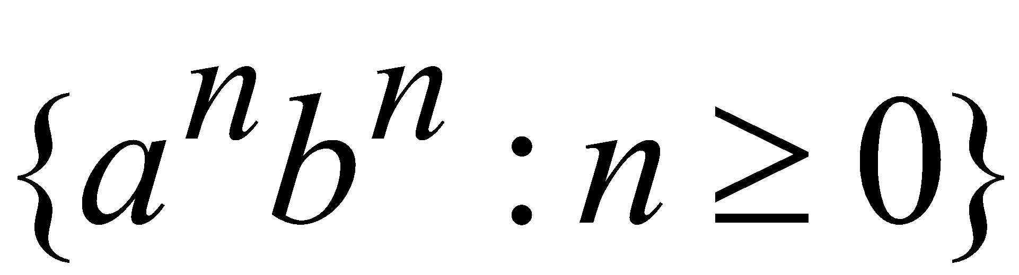
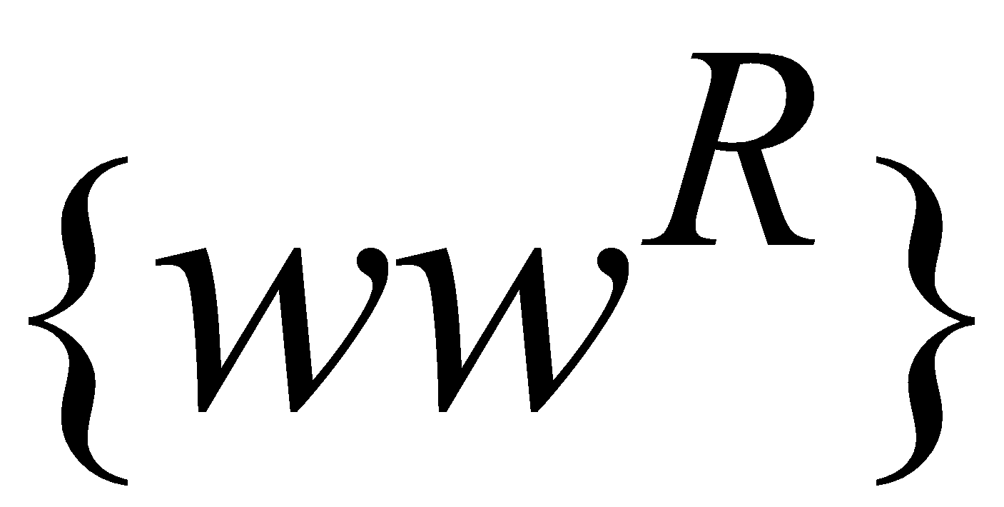
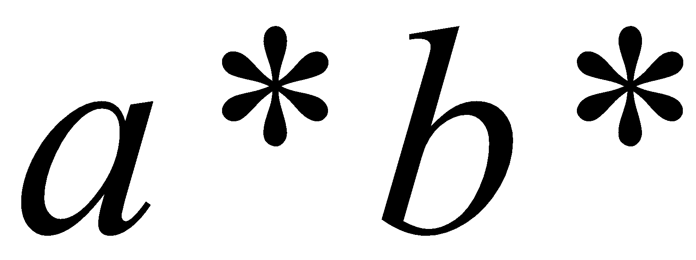
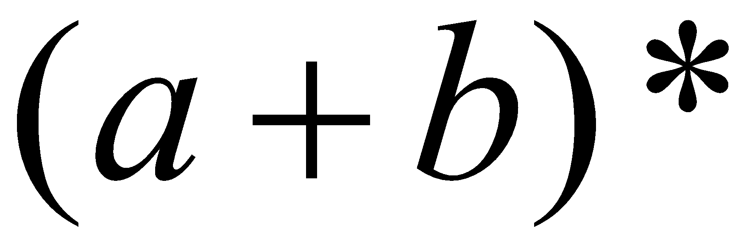
Context-Free Languages and Regular Languages
Context-Free Languages
Regular Languages

Slide 7
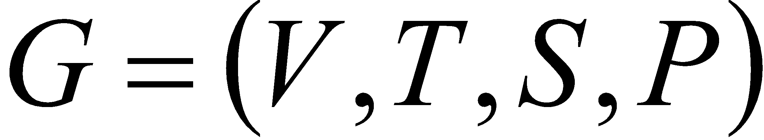
Formal Definition of a Grammar
Grammar:
Set of
variables
Set of
terminal
symbols
Start
variable
Set of
productions

Slide 8
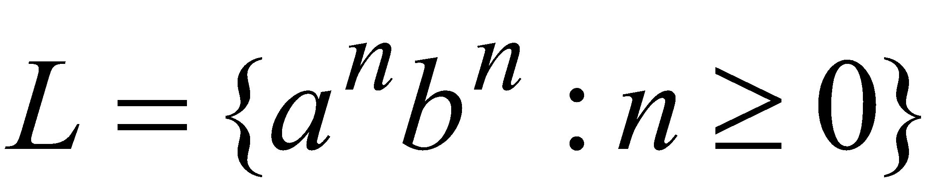
Language for the Grammar
Grammar:
S→aSb
S→є
Language of the grammar:

Slide 9
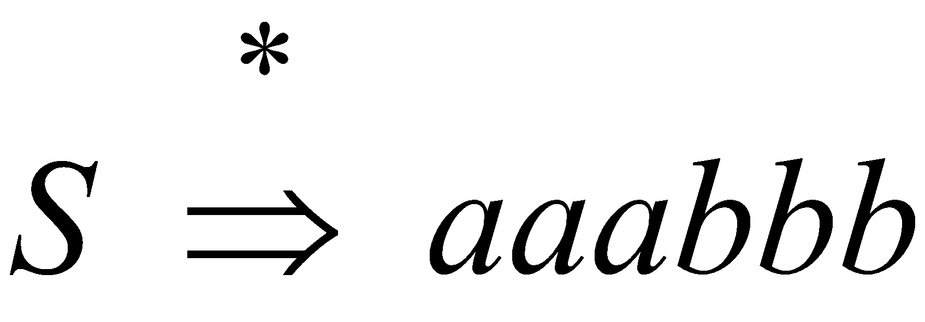
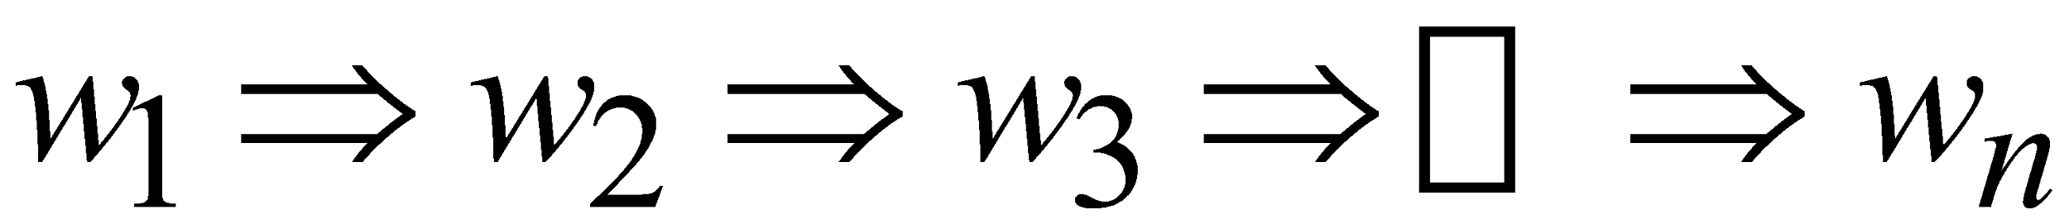
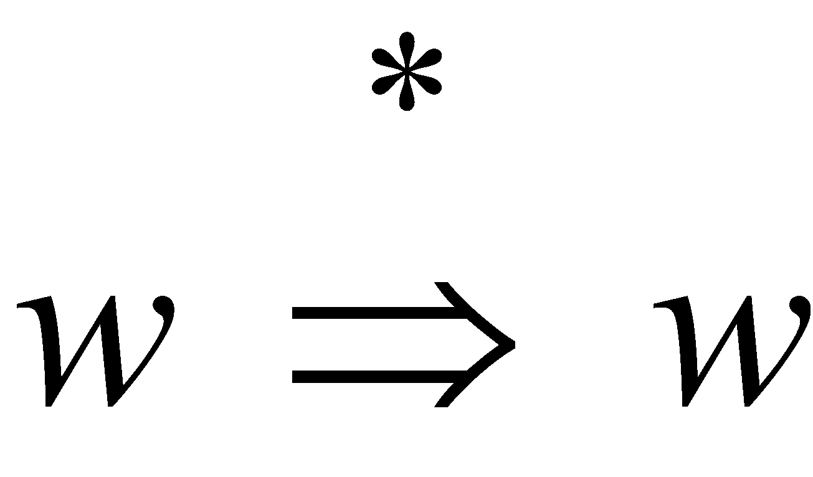
A Convenient Notation
We write:
Instead of:
Generalizing:
Trivially:
for zero or more derivation steps

Slide 10
Formal Definition-CFG
Definition: A context-free grammar is a 4-tuple (V, T, P, S), where:
V is a set (each element in V is called nonterminal)
T is an alphabet (each character in T is called terminal)
P, the set of rules, is a subset of V × (T ∪ V)*
    If (α,β) ∈ P, we write production α → β
    is called a sentential form
S, the start symbol, is one of the symbols in V

Slide 11
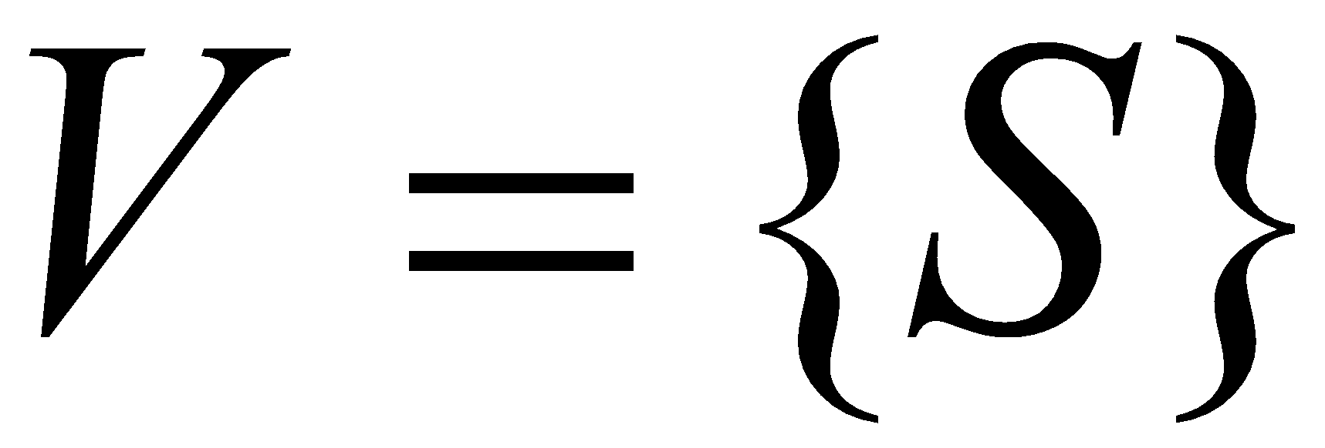
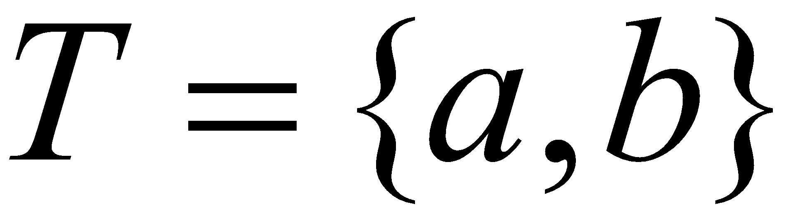
Example of Context-Free Grammar
productions
P={S→aSb,
S→є}
start variable
variables
terminals

Slide 12
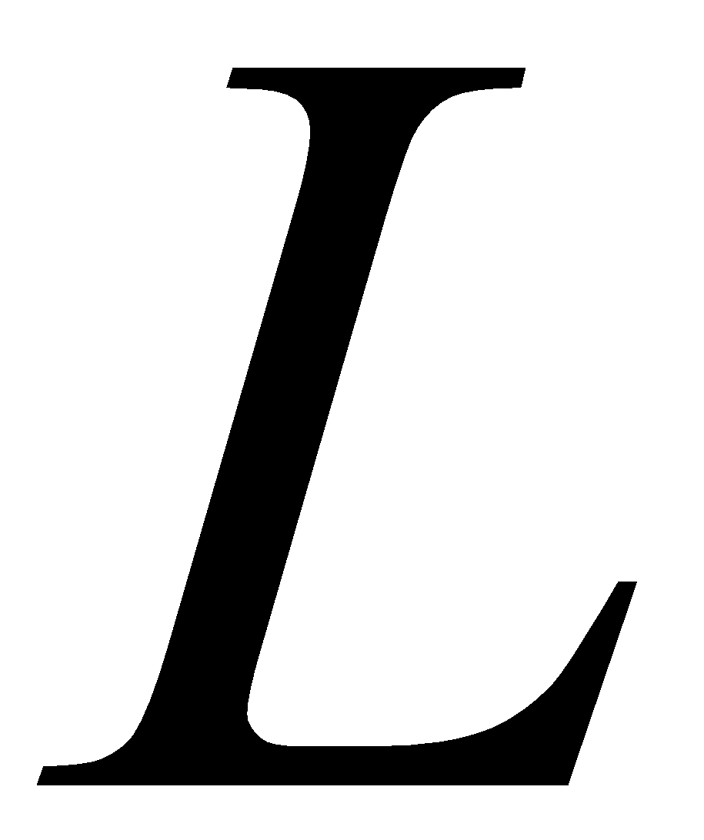

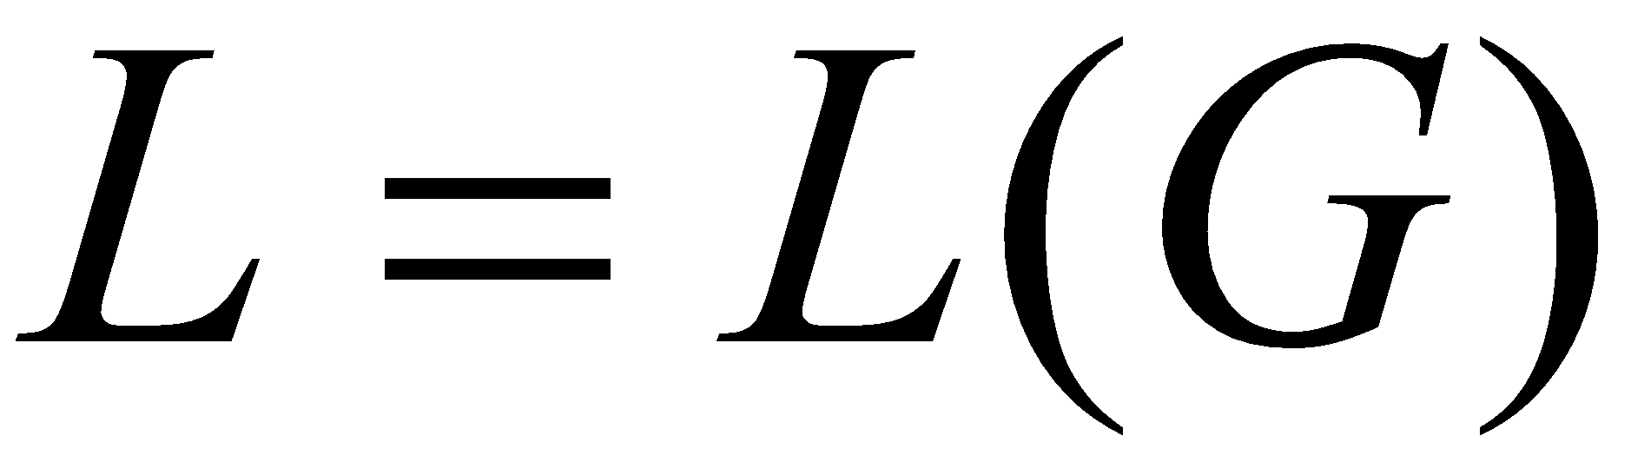
Context-Free Language
A language is context-free
if there is a context-free grammar
with

Slide 13
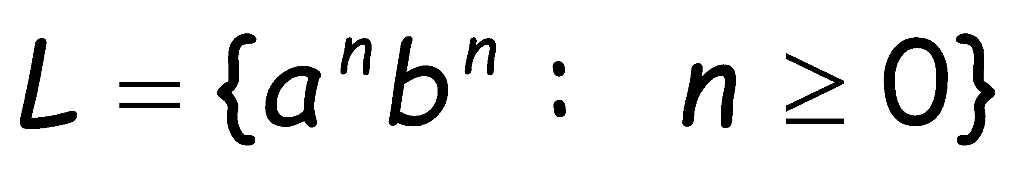

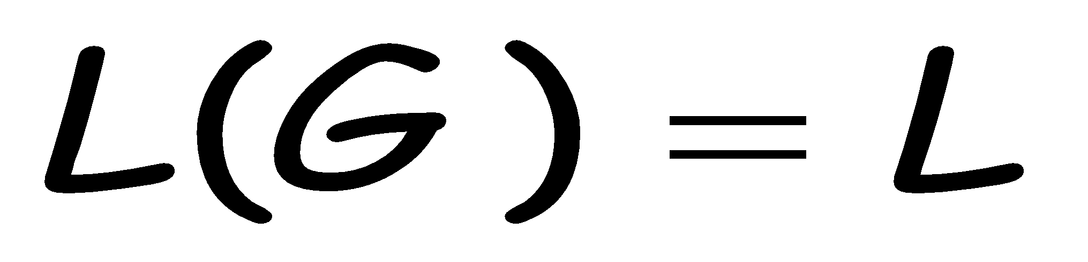
Context-Free Language-Example 1
is a context-free language
since context-free grammar :
{S→aSb | є}
generates

Slide 14

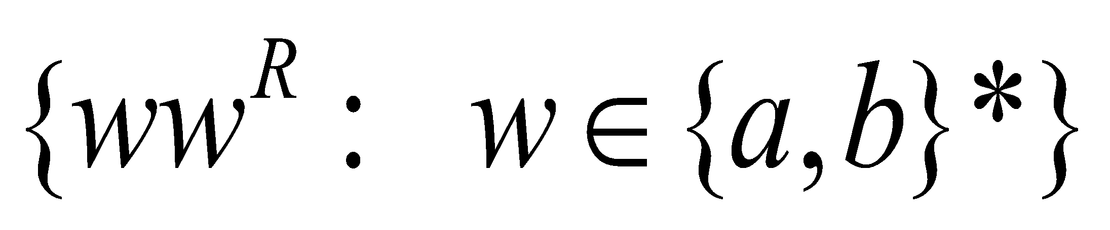
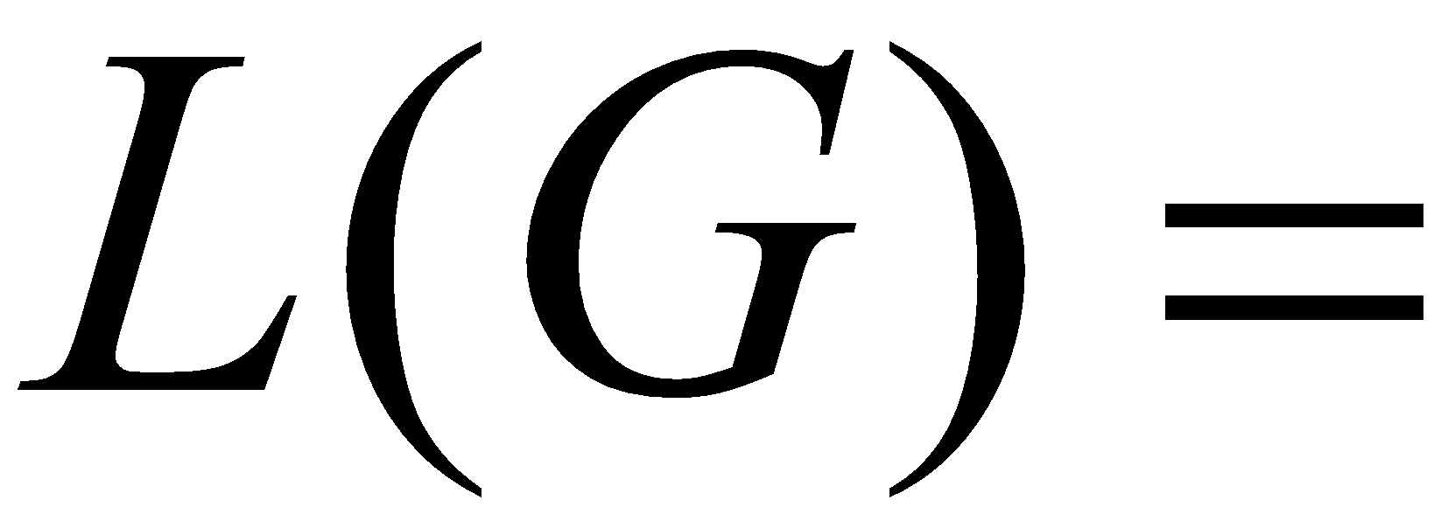
Context-Free Language – Example 2
Context-free grammar :
{S→aSa | bSb | є}
Example derivations:
Palindromes of even length

Slide 15
Derivation and Parse Trees
Consider the following example grammar
with 5 productions:
S→AB A→aaA|ϵ B→Bb|ϵ

Slide 16
Leftmost and Rightmost Derivation
Consider the following example grammar
with 5 productions:
S→AB A→aaA|ϵ B→Bb|ϵ
Leftmost derivation: for the string aab
Rightmost derivation: for the string aab

Slide 17




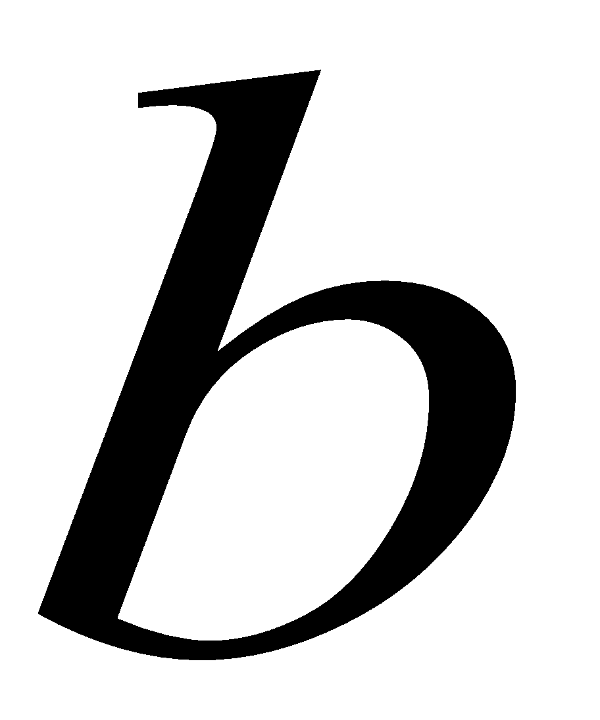
Leftmost and Rightmost Derivation
S→AB A→aaA|ϵ B→Bb|ϵ
Leftmost derivation:
Rightmost derivation:
Give same
derivation tree
ϵ
ϵ

Slide 18
Context Free Language for a CFG
Find the CFL generated for the given CFG.
S→aSb | ab
L(G)={a^{n}b^{n} | n>=1}
2. S→aB|bA
A→a|aS|bAA
B→b|bS|aBB
L(G)={x|x containing equal no of a’s and b’s}

Slide 19
CFG for a CFL
1. Write the grammar for generating strings over Σ={a}, containing any(zero or more) number of a’s.
S → a | aS | ϵ
2. Find the CFG represented by the RE (a+b)*
S → aS | bS | ϵ
3. Write the grammar for all strings consisting of a’s and b’s with atleast 2 a’s.
S→AaAaA
A→aA | bA | ϵ

Slide 20

Ambiguous Grammar
A context-free grammar is ambiguous
if there is a string which has:
two different derivation trees
or
two leftmost derivations
(Two different derivation trees give two
different leftmost derivations and vice-versa)

Slide 21
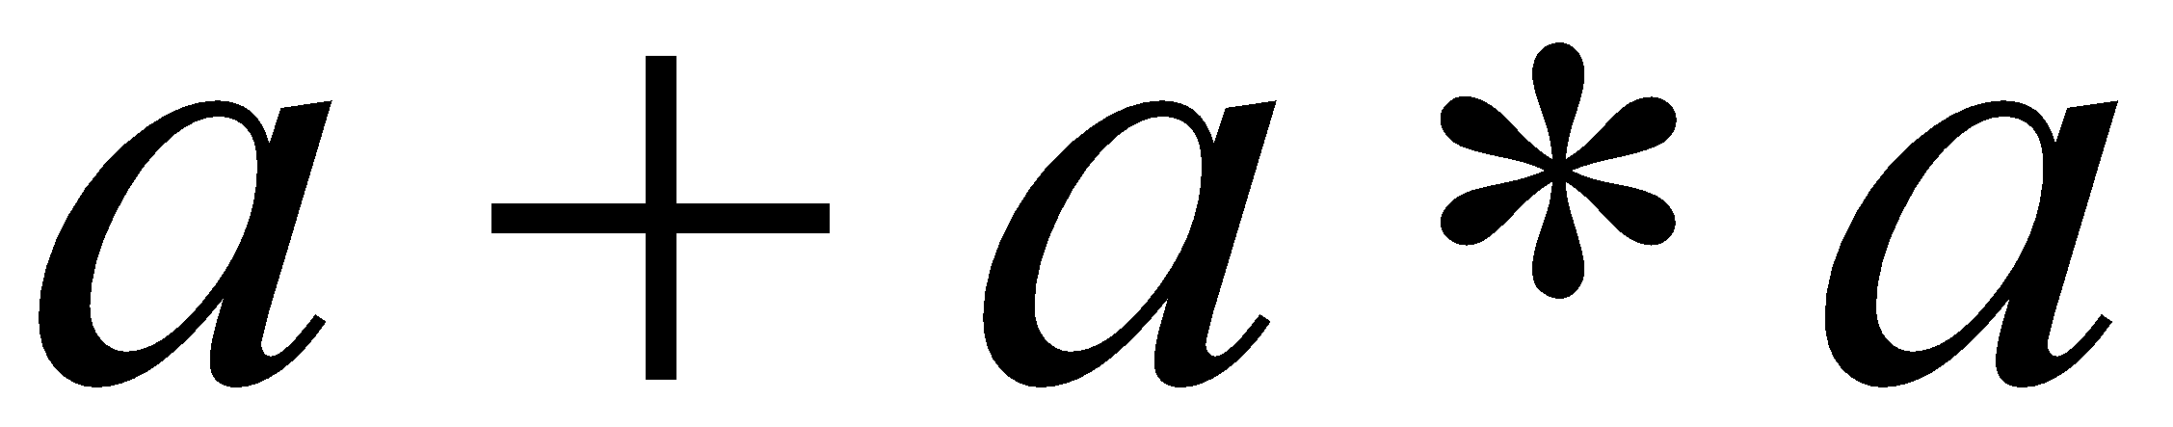



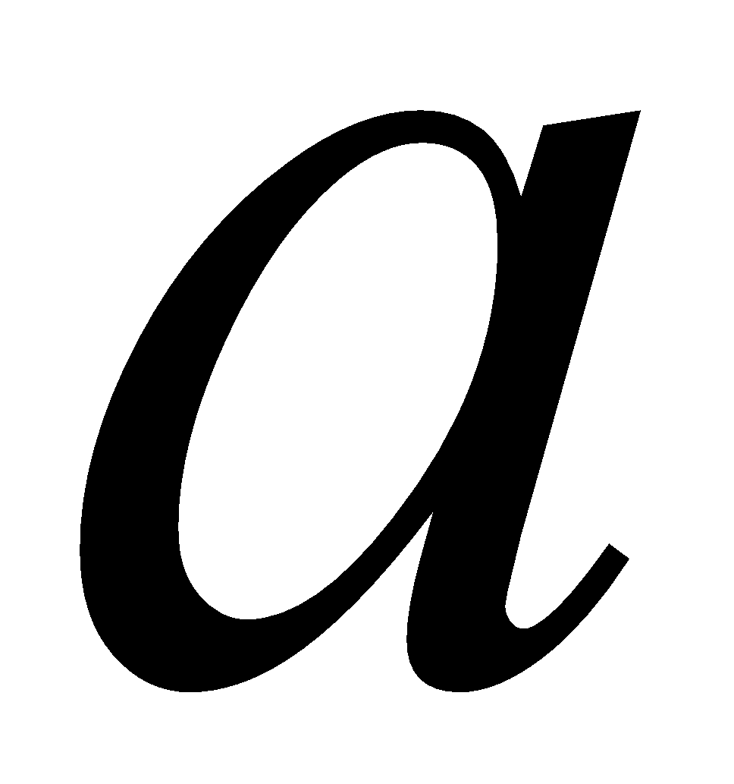
Ambiguous Grammar – An Example
string
has two derivation trees

Slide 22
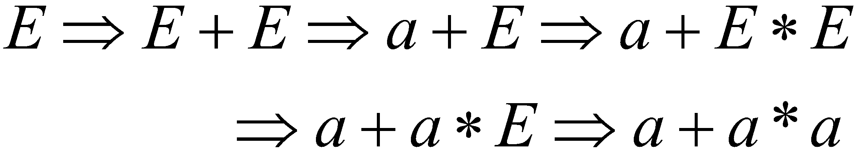
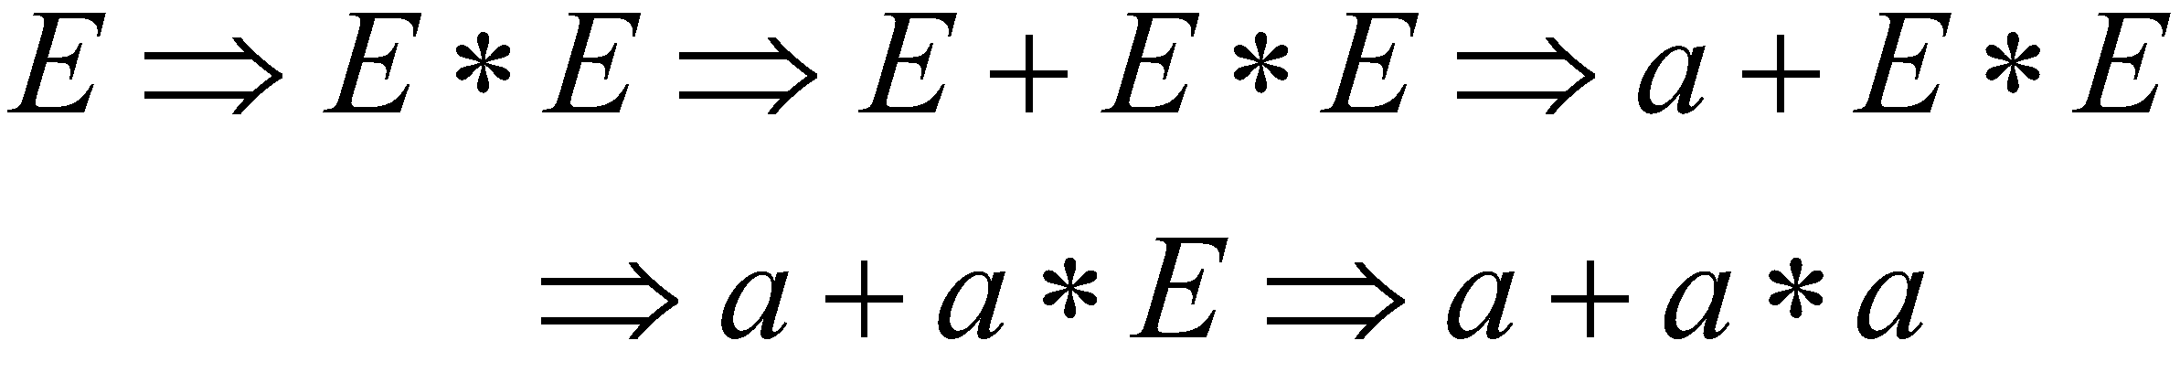
Ambiguous Grammar – An Example
string
has two leftmost derivations

Slide 23
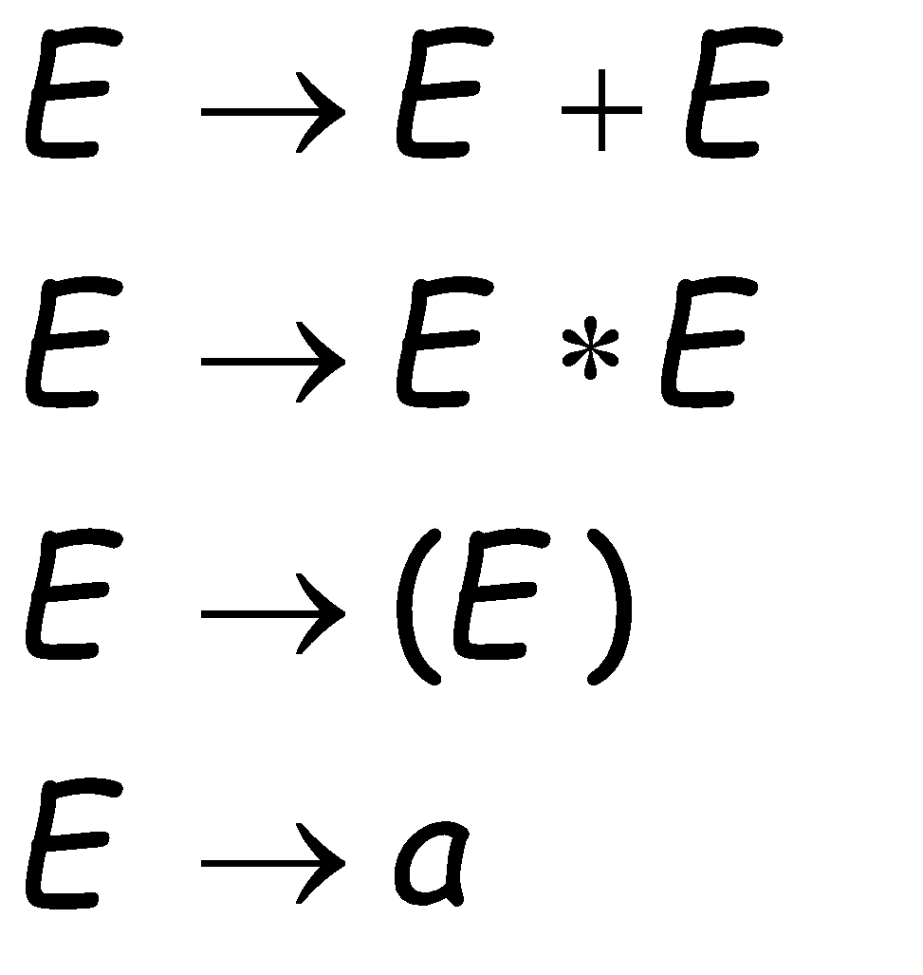
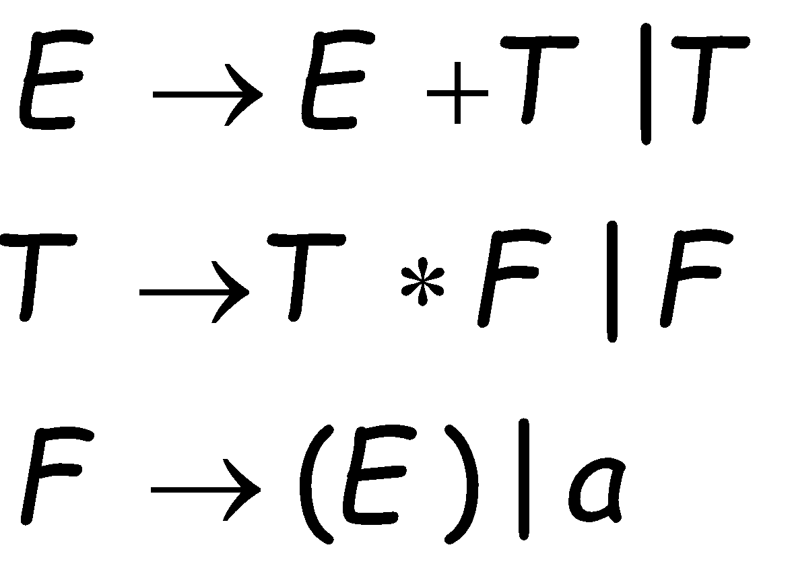
Removing Ambiguity
Equivalent
Ambiguous
Grammar
Non-Ambiguous
Grammar
generates the same
language

Slide 24
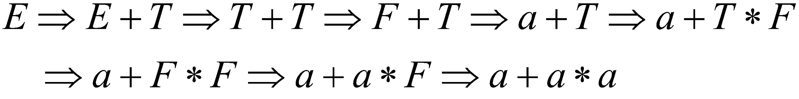

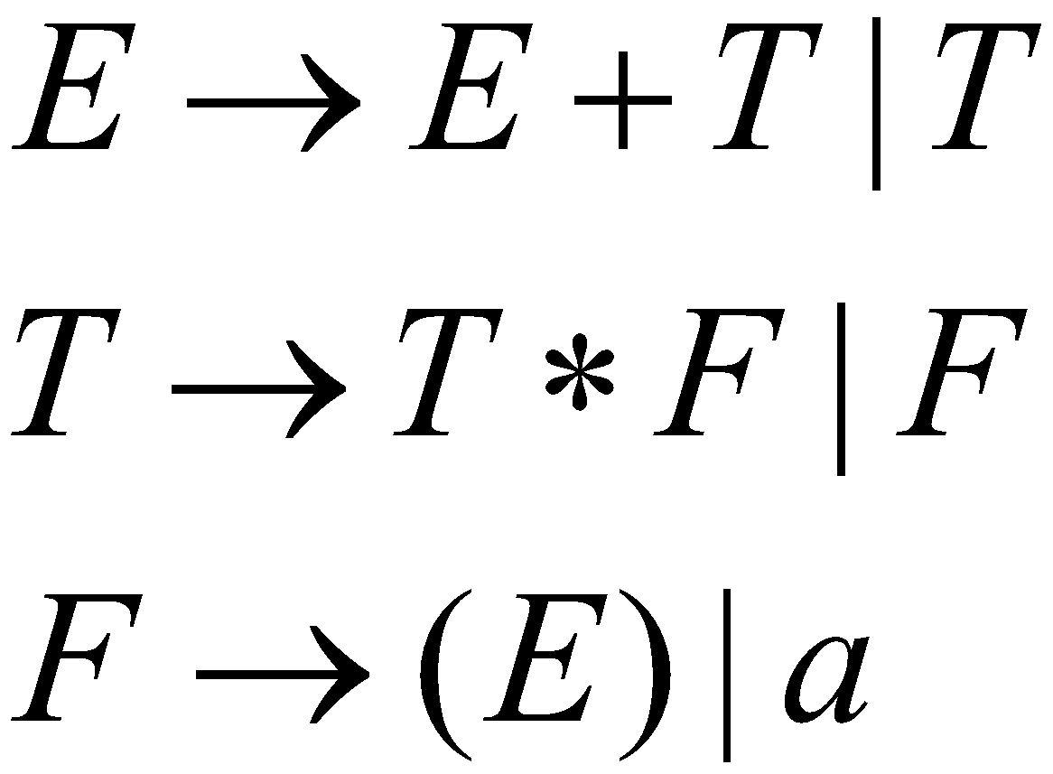




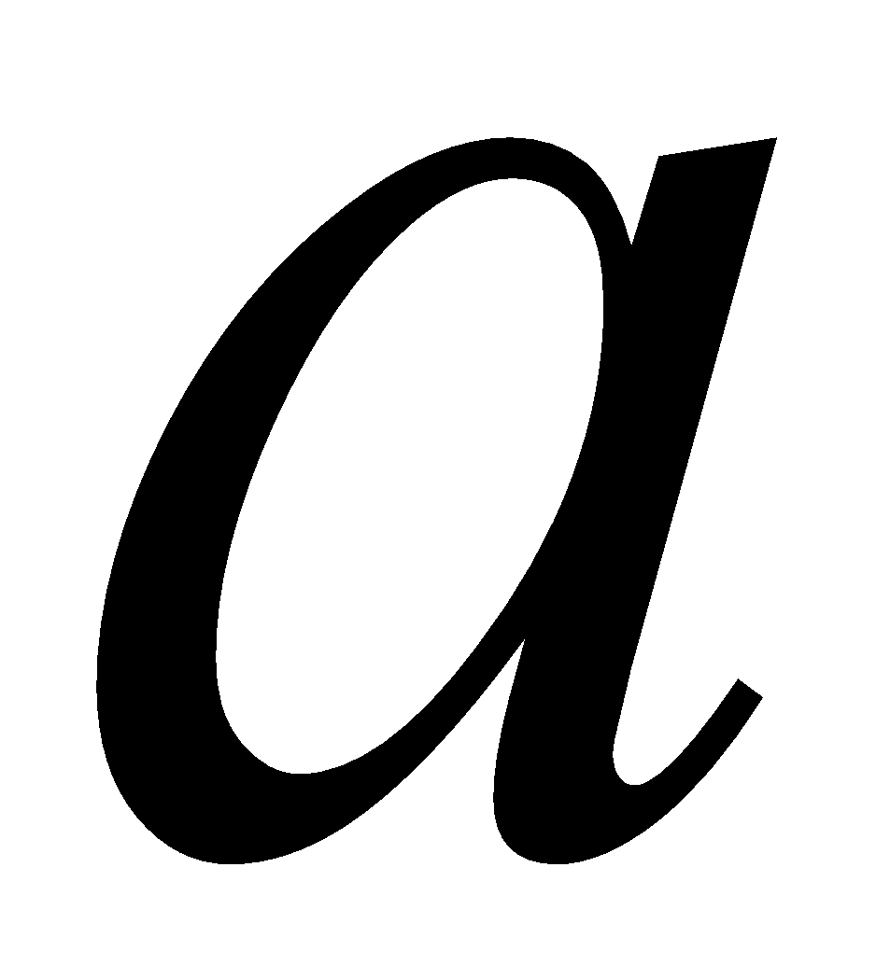
Unique derivation tree and leftmost derivation
For the string a+a*a

Slide 25
Simplification of Context Free Grammar
A CFG G can be simplified as:
Each variable and terminal of the CFG should appear in the derivation if at least one word in the L(G).
There should not be any production of the form A→B where A and B are both non-terminals.
Simplification techniques are:
1.Removal of Useless Symbols
2.Removal of Unit Productions
3.Elimination of ∈ production

Slide 26
Removal of Useless symbol
Ex.1 Consider the following grammar:
G={ (S,A),(1,0),P,S}
Where P consists of the following productions:
S→1 0|0 S 1|1 S 0|A|S S
Simplify the grammar by removing the useless symbols if any.
Remove S→A, as A is useless symbol.
S→1 0|0 S 1|1 S 0|S S

Slide 27
Removal of Useless symbol
Ex.2 Consider the following grammar:
G={ (S,A,B),(a),(1,0),P,S}
Where P consists of the following productions:
S→ A B | a
A→a
Simplify the grammar by removing the useless symbols if any.
B is useless, Remove B
S→A | a
A→ a

Slide 28
Removal of Unit Production
A production rule of the form A→B where A and B are both non-terminals is called a unit production.
All the other productions (including ∈ productions) are non-unit productions.
Ex.1 Consider the following grammar:
G={ (A,B),(a,b),P,A}
Where P consists of :
A→B, B→a | b
Simplify the grammar by removing the unit productions if any.
On eliminating unit production A→B
A→a|b

Slide 29
Removal of Unit Production
Ex.2Consider the following grammar:
S→ a | X b | a Y a | b | a a
X →Y
Y → b | X
Simplify the grammar by removing the unit productions if any.
Simplified grammar is:
S→a | Yb | aYa | b | aa
Y→ b

Slide 30
Removal of ∈ - Production
A production of the form A→ ∈ where A is non-terminal is known as ∈ - Production.
Ex.1 Consider the following grammar,
S→ a S a | b S b | ∈
Simplify the grammar by eliminating ∈ - Productions if any.
Simplified grammar is G’:
S → aSa | bSb | aa | bb
G’=G-ϵ rules.
L(G’)=L(G)-{ϵ}

Slide 31
Removal of ∈ - Production
Ex.2 Consider the following grammar,
S →a | X b | a Y a
X→Y | ∈
Y→b | X
Simplify the grammar by eliminating ∈ - Productions if any.
Simplified grammar is:
S → a | X b | a Y a | b | aa
X→ Y
Y→ b | X

Slide 32
Chomsky Hierarchy
Type 0 grammar (Unrestricted Grammar)
Type 1 grammar (Context Sensitive Grammar)
Type 2 grammar (Context Free Grammar)
Type 3 grammar (Regular Grammar)

Slide 33
Chomsky Hierarchy
Type 3 grammar:
It is also called as regular grammar.
A → α
Recognized by FSM.
Two types of Regular Grammar are:
Left Linear Grammar 2. Right Linear Grammar
Type 2 grammar:
It is also called as context free grammar.
A → α where A is NT and α is sentential form.
Start symbol of the Grammar can also appear on RHS.
Recognized by PDA(Pushdown Automata)

Slide 34
Chomsky Hierarchy
Type 1 grammar:
It is context sensitive grammar or context dependent.
α → β where length of β is at least as much as the length of α except S→ ∈.
The rule S→ ∈ is allowed only if start symbol S does not appear on RHS.
Productions are of the form
α₁Aα₂ →α1 β α₂ (β ≠ ∈)
Recognized by TM(Turing Machine).

Slide 35
Chomsky Hierarchy
Type 0 grammar:
It is unrestricted grammar that is no restriction on production.
α → β (α ≠ ∈)
Recognized by TM(Turing machines)
These languages are known as Recursively Enumerable Languages.

Slide 36
Normal Forms
There are certain standard ways of writing CFG.
They satisfy certain restrictions on the productions in the CFG.
Then the G is said to be in Normal forms.
Chomsky Normal Form (CNF)
Greibach Normal Form (GNF)

Slide 37
Chomsky Normal Form(CNF)
A CFG is in CNF if every production is of the form
A→ a, where A is NT and a is T
A → BC where A,B and C are NTs
S → ∈ is in G if ∈ belongs to L(G).
When ∈ is in L(G),
we assume that S does not appear on the RHS of any production.
e.g. G is :
S→AB| ∈
A→ a
B → b

Slide 38
Construction of G in CNF
Step 1. Elimination of null productions and unit productions using
previous method.
Let the G is (V,T,P,S)
Step 2. Elimination of terminals on RHS.
Step 3. Restricting the number of variables on RHS.
Notes:
Elimination of terminals on RHS:
We define G1 = (V’, T, P, S)
Where P1 and V’ are constructed as follows
All the productions in P of the form
A🡪 a or A🡪BC are included in P1.
All variables in V are included in V’.
Consider A🡪 X1X2…Xn with some terminal on RHS .
If X_{i} is a terminal say a₁, add a new variable C_{ai} to V’ and Cai 🡪 a_{i} to P1.
In production A🡪 X1X2…Xn every terminal on RHS is replaced by the corresponding new variable and the variable on RHS are retained.
The resulting production is added to P1.
Thus we get G1=(V’,T,P,S)
Step 3. Restricting the number of variables on RHS.
For any production in P1 the RHS consists of
either a single terminal (or ∈ in S🡪∈)or two or
more variables.
We define G2= (V’’,T,P2,S) as follows:
All productions in P1 are added to P2 if they are in required form.All the variables in V’ are added to V’’.
Consider A🡪 A1A2…Am where m ≥ 3.
We introduce new productions
A🡪A1C1 , C1🡪A2C2….Cm-2🡪Am-1Am
And new variables C1,C2,…Cm-2.
These are added to P2 and V’’ resp.
Thus we get G2 in CNF.

Slide 39
Reduce to CNF
1. Convert to CNF, S→aSa | bSb | a | b | aa | bb
Adding A→a and B→b we can rewrite the grammar as
S→ASA|BSB|a|b|AA|BB
A→a, B→b
Only S→ASA and S→BSB are not in CNF
For S→ASA we can write
S→AR₁, R₁ →SA
For S→BSB we can write
S→BR₂, R₂→SB
Grammar in CNF is
S→AR₁|BR₂|a|b|AA|BB
A→a, B→b
R₁→SA, R₂→SB

Slide 40
Reduce to CNF
2. Convert to CNF,
S→bA|aB, A→bAA|aS|a, B→aBB|bS|b
Add R₁→a, R₂→ b
Rewriting the grammar,
S→ R₂ A| R₁ B,
A→ R₂ AA| R₁ S|a,
B→R₁ BB| R₂ S|b
R₁→a, R₂→b
A→R₂ AA and B→ R₁ BB are not in CNF
Converted grammar in CNF is
S→R₂ A| R₁ B,
A→R₂ R₃| R₁ S|a, R₃→AA
B→R₁ R₄ | R₂ S|b, R₄ →BB
R₁→a, R₂→b

Slide 41
Greibach Normal Form
A context free grammar is said to be in Greibach Normal Form if all productions are in the following form:
A → αX
A is a non terminal symbols
α is a terminal symbol
X is a sequence of non terminal symbols.
It may be empty.

Slide 42
Closure properties of CFL
CFLs are closed under:
  Union
  Concatenation
  Kleene closure operator
  Substitution
  Homomorphism, inverse homomorphism
  Reversal
CFLs are not closed under:
  Intersection
  Difference
  Complementation

Slide 43
Push Down Automata

Slide 44
Context-Free Languages
Context-Free
Grammars
Pushdown
Automata
stack
automaton

Slide 45
Pushdown Automaton - PDA
Input String
Stack
States

Slide 46


Initial Stack Symbol
Stack
Stack
stack
head
top
bottom
special symbol
Appears at time 0

Slide 47
Formal definition of PDA
The PDA is as:
A =(Q,Σ, Г ,δ,q₀,Z₀,F)
Where
Q : A finite set of states
Σ : A finite set of input symbols
Г : A finite stack alphabet or pushdown symbols
δ : the transition function Q X(Σ U {ϵ } ) X Г to the set of finite subsets of Q X Г*
q_{0:} the start state
Z₀ : the start symbol(pushdown symbol)
F : the set of accepting state or final states

Slide 48
Transition Function
δ :The transition function is a triple δ(q,a,x)
where
1. q is a state in Q
2. a is either an input symbol in Σ or a =ϵ, the empty string,
3. x is a stack symbol, that is a member of Г.
The output of δ is a finite set of pairs (p,ɤ )
Where
p is the new state and
ɤ is the string of stack symbols that replaces x at the top of the stack.

Slide 49
Instantaneous Description of a PDA
The configuration of a PDA by a triple (q,w,ɤ) where
q is the state
w is the remaining input
ɤ is the stack contents
we show the top of the stack at the left end of ɤ and the bottom at the right end.
Such a triple is called an Instantaneous Description or ID of a PDA.

Slide 50


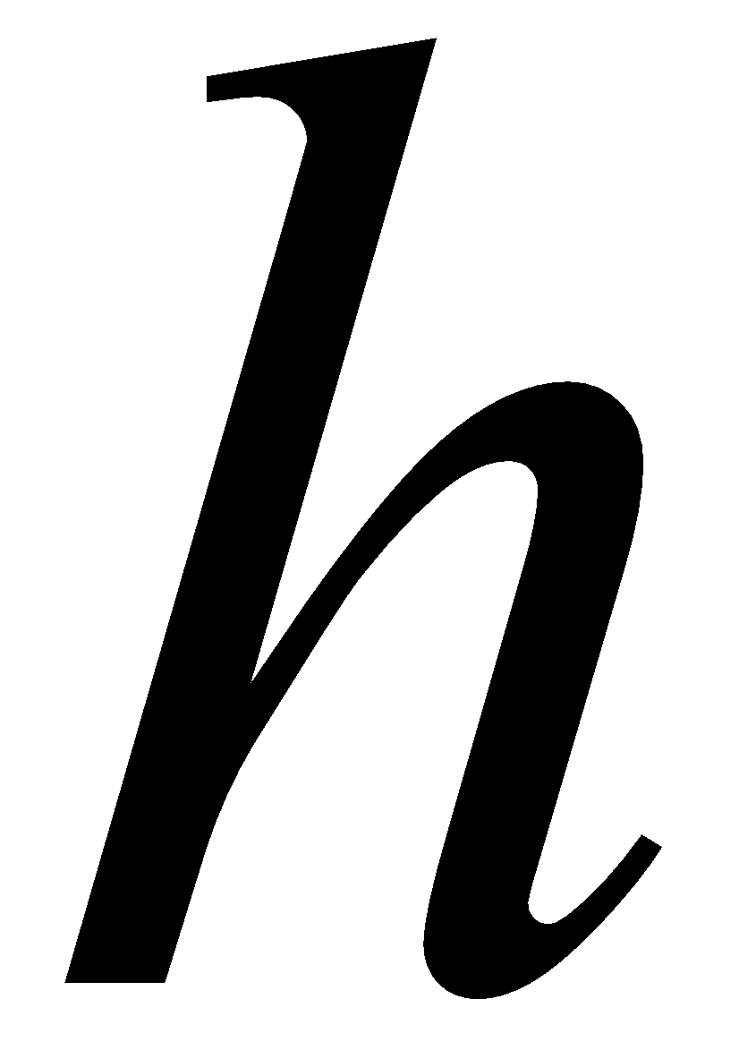


δ(q, a, b) = (q, c)
stack
top
Replace

Slide 51
δ(q, a, b) = (q, cb)
stack
top
Push

Slide 52
δ(q, a, b) = (q, ϵ)
stack
top
Pop

Slide 53
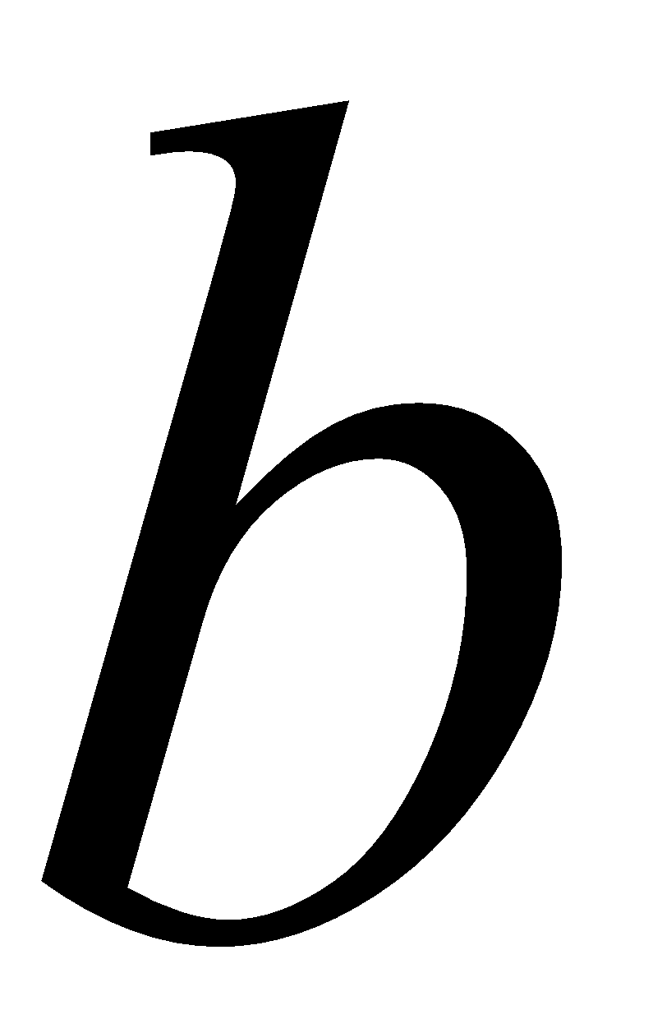
δ(q, a, b) = (q, b)
stack
top
No Change

Slide 54
A PDA Example
A =(Q,Σ, Г ,δ,q₀,Z₀,F)
Q={q₀, q₁, q₂}, Σ={a,b}, Г={Z₀, a}, F={q₂}, δ as below
Move no | State | input | stack symbol | Move
1 | q₀ | a | Z₀ | (q₀,aZ₀)
2 | q₀ | a | a | (q₀,aa)
3 | q₀ | b | a | (q₁, ∈)
4 | q₁ | b | a | (q_{1,}∈)
5 | q₁ | ∈ | Z₀ | (q₂, Z₀)

Slide 55
Acceptance by PDA using final state
Move no | State | input | stack symbol | Move
1 | q₀ | a | Z₀ | (q₀,aZ₀)
2 | q₀ | a | a | (q₀,aa)
3 | q₀ | b | a | (q₁, ∈)
4 | q₁ | b | a | (q_{1,}∈)
5 | q₁ | ∈ | Z₀ | (q₂, Z₀)
For the string aabb
(q_{0,} aabb , Z₀)
Ⱶ (q_{0,} abb , aZ₀)
Ⱶ (q_{0,} bb , aaZ₀)
Ⱶ (q_{1,} b , aZ₀)
Ⱶ (q_{1,} ∈ , Z₀)
Ⱶ (q_{2,}∈ , Z₀)
String aabb is accepted, as final state q2 is reached on reading string aabb completely

Slide 56
Rejection by PDA
Move no | State | input | stack symbol | Move
1 | q₀ | a | Z₀ | (q₀,aZ₀)
2 | q₀ | a | a | (q₀,aa)
3 | q₀ | b | a | (q₁, ∈)
4 | q₁ | b | a | (q_{1,}∈)
5 | q₁ | ∈ | Z₀ | (q₂, Z₀)
For the string aabbb
(q_{0,} aabbb , Z₀)
Ⱶ (q_{0,} abbb , aZ₀)
Ⱶ (q_{0,} bbb , aaZ₀)
Ⱶ (q_{1,} bb , aZ₀)
Ⱶ (q_{1,} b , Z₀)
String aabbb is rejected as q₁ is not final state and string aabbb is not read completely.

Slide 57
Acceptance by PDA using null store or empty store or empty stack
Move no | State | input | stack symbol | Move
1 | q₀ | a | Z₀ | (q₀,aZ₀)
2 | q₀ | a | a | (q₀,aa)
3 | q₀ | b | a | (q₁, ∈)
4 | q₁ | b | a | (q_{1,}∈)
5 | q₁ | ∈ | Z₀ | (q₁, ∈)
For the string aabb
(q_{0,} aabb , Z₀)
Ⱶ (q_{0,} abb , aZ₀)
Ⱶ (q_{0,} bb , aaZ₀)
Ⱶ (q_{1,} b , aZ₀)
Ⱶ (q_{1,} ∈ , Z₀)
Ⱶ (q_{1,}∈ , ∈)
String aabb is accepted, as stack is empty on reading string aabb completely

Slide 58
Rejection by PDA
Move no | State | input | stack symbol | Move
1 | q₀ | a | Z₀ | (q₀,aZ₀)
2 | q₀ | a | a | (q₀,aa)
3 | q₀ | b | a | (q₁, ∈)
4 | q₁ | b | a | (q_{1,}∈)
5 | q₁ | ∈ | Z₀ | (q₁, ∈)
For the string aabbb
(q_{0,} aabbb , Z₀)
Ⱶ (q_{0,} abbb , aZ₀)
Ⱶ (q_{0,} bbb , aaZ₀)
Ⱶ (q_{1,} bb , aZ₀)
Ⱶ (q_{1,} b , Z₀)
String aabbb is rejected as string aabbb is not read completely and stack is not empty.

Slide 59
Acceptance by PDA
Acceptance of input strings by PDA can be defined in terms of final states or in terms of PDS(pushdown store).
Let A= (Q,Σ, Г ,δ,q₀,Z₀,F) be a PDA.
The set accepted by final state is defined by
T(A) ={w ϵ Σ* | (q_{0,}w,Z₀ ) Ⱶ * (q_{f ,} ʌ, α ) for some q_{f} ϵ F and α ϵ Г*}
The set accepted by null store(or empty store)is defined by
N(A) = {w ϵ Σ* | (q_{0,}w,Z₀ ) Ⱶ * (q , ʌ, ʌ ) for some q ϵ Q }

Slide 60
PDA for L={a^{n}b^{n} | n>0 }
Logic:
W
Let
A= (Q, Σ, Г , δ, q₀, Z₀, F)
Q={q₀,q₁},
Σ={a,b},
Г={a,Z₀},
F={q₁}
is a PDA.

Slide 61
δ (Transition Function) by Final State is
Move no | State | input | stack symbol | Move
1 | q₀ | a | Z₀ | (q₀,aZ₀)
2 | q₀ | a | a | (q₀,aa)
3 | q₀ | b | a | (q₁, ∈)
4 | q₁ | b | a | (q_{1,}∈)
5 | q₁ | ∈ | Z₀ | (q₁, Z₀)
Acceptance of a string aabb
(q_{0,} aabb , Z₀) Ⱶ (q_{0,} abb , aZ₀) Ⱶ (q_{0,} bb , aaZ₀) Ⱶ (q_{1,} b , aZ₀) Ⱶ (q_{1,} ∈ , Z₀)

Slide 62
δ (Transition Function) by Empty stack or Empty store or Null stack is
Move no | State | input | stack symbol | Move
1 | q₀ | a | Z₀ | (q₀,aZ₀)
2 | q₀ | a | a | (q₀,aa)
3 | q₀ | b | a | (q₁, ∈)
4 | q₁ | b | a | (q₁∈)
5 | q₁ | ∈ | Z₀ | (q₁, ∈)
Acceptance of a string aabb
(q_{0,} aabb , Z₀) Ⱶ (q_{0,} abb , aZ₀) Ⱶ (q_{0,} bb , aaZ₀) Ⱶ (q_{1,} b , aZ₀) Ⱶ (q_{1,} ∈ , Z₀) Ⱶ (q_{1,} ∈ , ∈)

Slide 63
Ex: PDA to accept language of palindromes with the marker. i.e. L={xcx^{r} | x ∈ {a,b}*}
Let
A= (Q, Σ, Г , δ, q₀, Z₀, F) is a PDA.
where
Q={q₀,q₁,q_{f}},
Σ={a,b,c},
Г={a,b,Z₀},
F={q_{f}}

Slide 64
δ (Transition Function) by Final State is
Move no | State | input | stack symbol | Move
1 | q₀ | a | Z₀ | (q₀,aZ₀)
2 | q₀ | b | Z₀ | (q₀,bZ₀)
3 | q₀ | a | a | (q₀,aa)
4 | q₀ | b | b | (q₀,bb)
5 | q₀ | a | b | (q₀, ab)
6 | q₀ | b | a | (q₀, ba)
7 | q₀ | c | Z₀ | (q₁,Z₀)
8 | q₀ | c | a | (q₁,a)
9 | q₀ | c | b | (q₁,b)
10 | q₁ | a | a | (q₁, ∈)
11 | q₁ | b | b | (q₁, ∈)
12 | q₁ | ∈ | Z₀ | (q_{f}, Z₀)

Slide 65
δ (Transition Function) by Empty stack or Empty store or Null stack is
Move no | State | input | stack symbol | Move
1 | q₀ | a | Z₀ | (q₀,aZ₀)
2 | q₀ | b | Z₀ | (q₀,bZ₀)
3 | q₀ | a | a | (q₀,aa)
4 | q₀ | b | b | (q₀,bb)
5 | q₀ | a | b | (q₀, ab)
6 | q₀ | b | a | (q₀, ba)
7 | q₀ | c | Z₀ | (q₁,Z₀)
8 | q₀ | c | a | (q₁,a)
9 | q₀ | c | b | (q₁,b)
10 | q₁ | a | a | (q₁, ∈)
11 | q₁ | b | b | (q₁, ∈)
12 | q₁ | ∈ | Z₀ | (q₁, ∈ )

Slide 66
Examples for practice
PDA for L={a^{n}b^{2n} | n>0}
PDA for L={a^{n}b^{n}c^{m}d^{m} | n, m>0 }
PDA for L={a^{n}b^{m}c^{m} | m, n>0}

Slide 67
Deterministic and non-deterministic PDA
DPDA:
transition function is :
Q X Σ X Г → Q X Г*
e.g. δ(q,a,Z) is either empty or a singleton.
δ(q,a,Z) ≠ Ø
NPDA:
Q X Σ U {ϵ } X Г → finite subsets of Q X Г*
e.g. δ(q,a,Z) = {(p1,ɤ1) ,(p2, ɤ2)…..(pm, ɤm)}

Slide 68
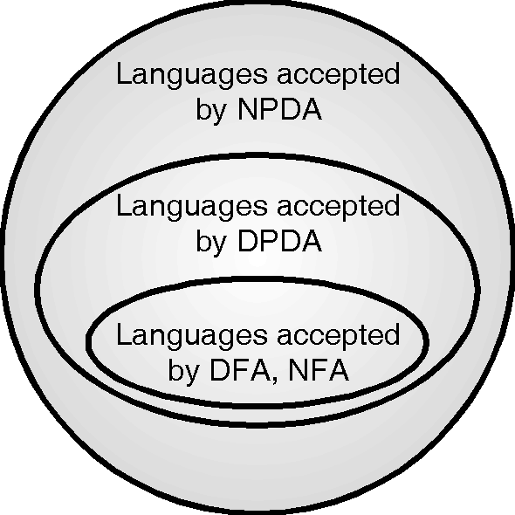
DPDA and NPDA

Slide 69
NPDA and DPDA
For every NPDA, there may not exist an equivalent DPDA.
The NPDA can accept any CFL, while DPDA is a special case of NPDA that accepts only a subset of the CFLs accepted by the NPDA.
Thus, DPDA is less powerful than NPDA.

Slide 70
NPDA to accept language of palindromes without the marker.
Let
A= (Q, Σ, Г , δ, q₀, Z₀, F) is a PDA.
where
Q={q₀,q₁,q_{f}},
Σ={a,b},
Г={a,b,Z₀},
F={q_{f}}

Slide 71
NPDA to accept language of all palindrome strings
Move no | State | input | stack symbol | Move
1 | q₀ | a | Z₀ | {(q₀,aZ₀), (q₁, Z₀)}
2 | q₀ | b | Z₀ | {(q₀,bZ₀), (q₁, Z₀)}
3 | q₀ | a | a | {(q₀,aa),(q₁,a)}
4 | q₀ | b | a | {(q₀,ba), (q₁,a)}
5 | q₀ | a | b | {(q₀, ab), (q₁,b)}
6 | q₀ | b | b | {(q₀, bb), (q₁,b)}
7 | q₀ | ∈ | Z₀ | {(q₁,Z₀)}
8 | q₀ | ∈ | a | {(q₁,a)}
9 | q₀ | ∈ | b | {(q₁,b)}
10 | q₁ | a | a | {(q₁, ∈)}
11 | q₁ | b | b | {(q₁, ∈)}
12 | q₁ | ∈ | Z₀ | {(q_{f}, Z₀)}

Slide 72
CFG to PDA
Theorem: If L is a CFL then we can construct a PDA A accepting L by empty store ie. L=N(A).
Proof: We construct A by making use of productions in G.
Let L=L(G) where G=(V, T, P, S) is a CFG.
We construct PDA A as
A= (Q, Σ, Г , δ, q, Z₀,F)
where Σ=T
Г is (V U T)
Z₀ = S
F = Ф
δ is defined as
R₁ : δ(q, ∈, A) = {(q, α ) | A→ α is in P}
R₂ : δ(q, a, a) = {(q, ∈ ) } for every a in Σ.

Slide 73
CFG to PDA
1 .Construct a PDA for the CFG
S→ 0BB
B→0S | 1S |0
Test whether 010⁴ is in N(A).
We construct PDA A as
A = (Q, Σ, Г , δ, q, Z₀,F)
Q = {q}
Σ = {0,1}
Г = {S, B, 0, 1}
Z₀= S
F = Ф
Move no | State | input | stack symbol | Move
1 | q | ∈ | S | {(q,0BB)}
2 | q | ∈ | B | {(q,0S), (q,1S), (q,0)}
3 | q | 0 | 0 | {(q, ∈)}
4 | q | 1 | 1 | {(q,∈)}

Slide 74
CFG to PDA
1 .Construct a PDA for the CFG
S→ 0BB
B→0S | 1S |0
Test whether 010⁴ is in N(A).
2. Convert the grammar
S→aSb | A
A→bSa |S| ∈
To a PDA that accepts the same language by empty stack.

Slide 75
PDA to CFG
For the given PDA A = ({q₀,q₁}, {0,1}, {X, Zo}, δ, q₀, Zo)
with δ as:
δ(q0,0,Z0) = (q0,XZo) (1a)
δ(q0,0,X) = (q0,XX) (1b)
δ(q0,1,X) = (q1, ∈) (2a)
δ(q1,1,X) = (q1, ∈) (2b)
δ(q1, ∈,X) = (q1, ∈) (2c)
δ(q1, ∈,Zo) = (q1, ∈) (2d)
We convert into CFG as follows
Σ = {0,1} (same as sigma from the PDA)
1. Define Start Symbol "S".
2. [pXq] where p& q are states in Q and X is from Г
V = (S, [q0,X,q0], [q0,X,q1], [q1,X,q0], [q1,X,q1], [q0,Zo,q0], [q0,Zo,q1], [q1,Zo,q0], [q1,Zo,q1])

Slide 76
PDA to CFG
For the productions the rules are
1. For starting symbol S we write productions S → [q0,Zo,p]
E.g.
S → [q0,Zo,q0]
S → [q0,Zo,q1]
2. Now, We will derive forward, only building productions for variables that can be derived.
Let δ(q0,a,X) = (r, y₁y₂y₃y₄…y_{k})
Then (q0 X r_{k}) →a [r y1 r1], [r1 y2 r2], [r2 y3 r3], ….. [rk-1 yk rk],
For all states r1,r2,……rk
δ(q0,a,X) = (r, ∈) then [q0 X r] → a
δ(q0, ∈,X) = (r, ∈) then [q0 X r] → ∈

Slide 77
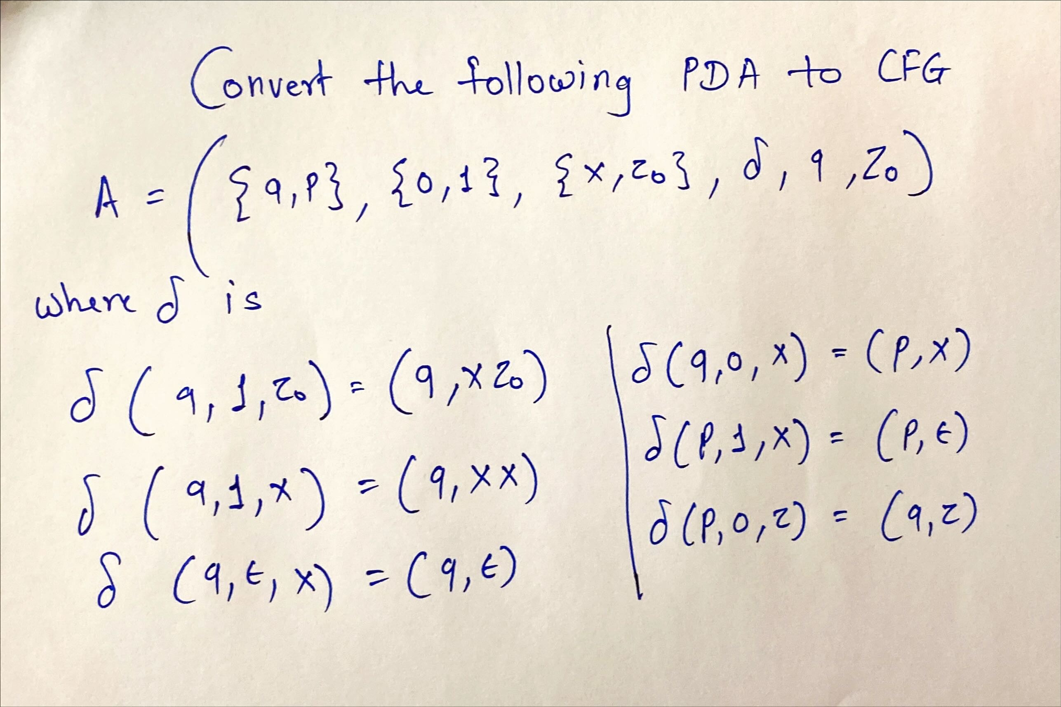
PDA to CFG
Example:

Slide 78
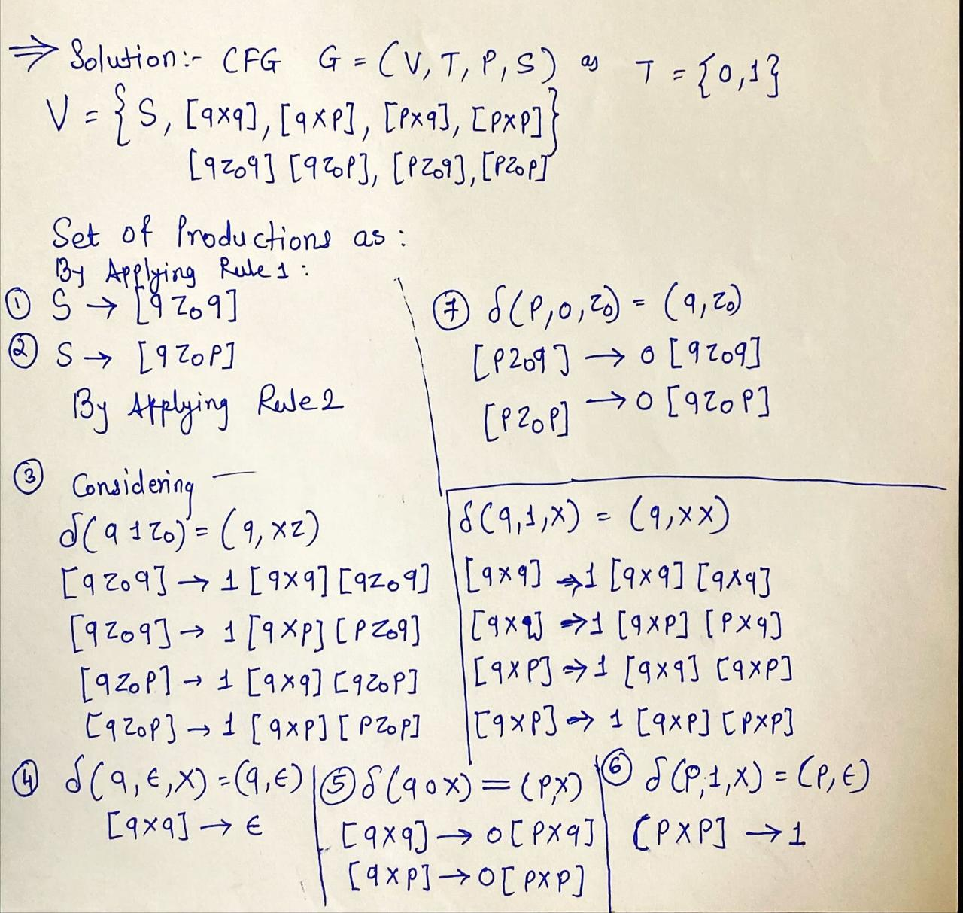
PDA to CFG
Solution:

Slide 79
Applications
Context Free Grammar (CFG) is of great practical importance.
It is used for the following purposes-
For defining programming languages
For parsing the program by constructing a syntax tree
For translation of programming languages
For describing arithmetic expressions
For construction of compilers

Slide 80
Thank You…!!!

